Slide 1
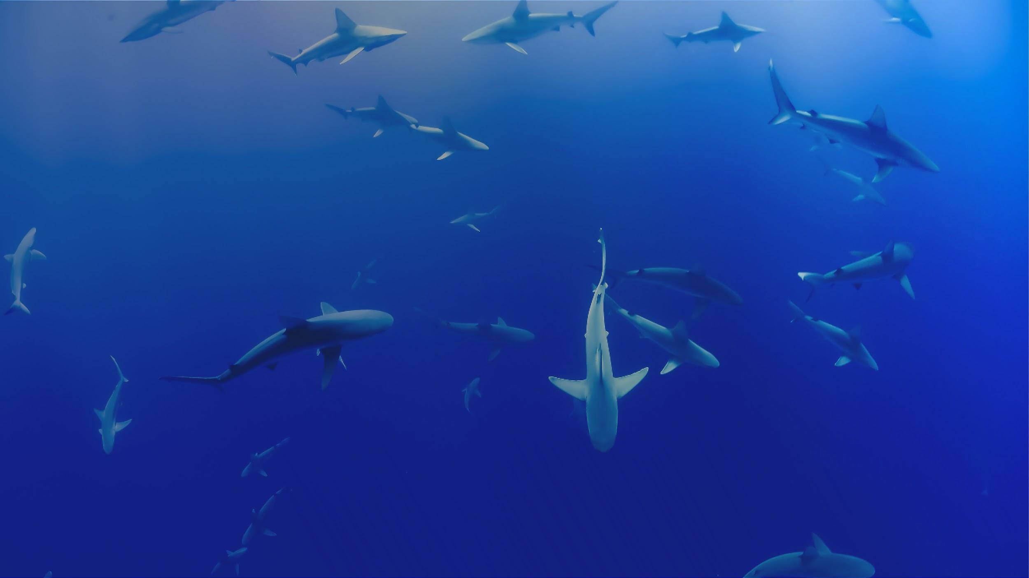


More Ways to Contribute to OBIS
Jon Pye, Brian Jones, Naomi Tress
Ocean Tracking Network Data Centre
Notes:
So now that we’ve worked in the ecosystem a little bit, and hopefully we’re on board with the general mission of OBIS and want to see it succeed, let’s talk about some of the indirect ways you might be able to support this initiative.

Slide 2

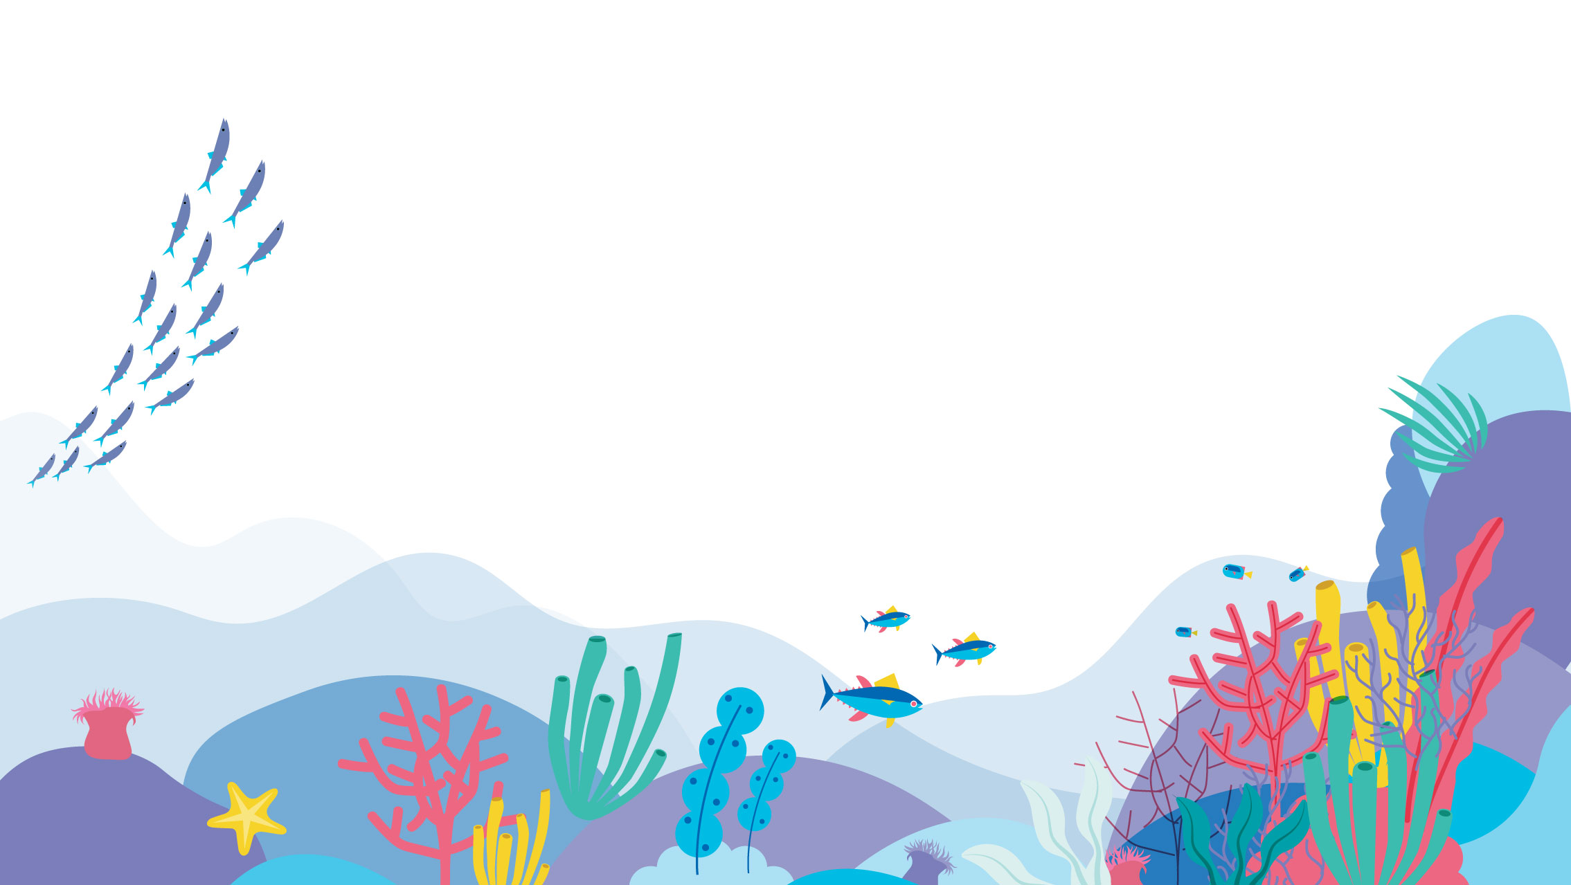







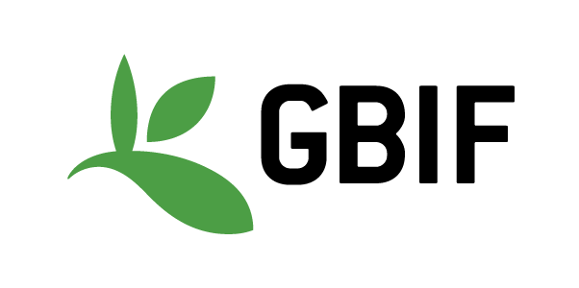


Notes:
As we’ve explored during the week, OBIS is a concept that is sustained and empowered by the efforts of a network of organizations, an assemblage of institutions that build data sharing software, design and maintain complex data systems, work out and evolve biological data standards and controlled vocabularies, and work within their areas of authority or expertise to produce datasets that conform to those standards and vocabularies.

Slide 3
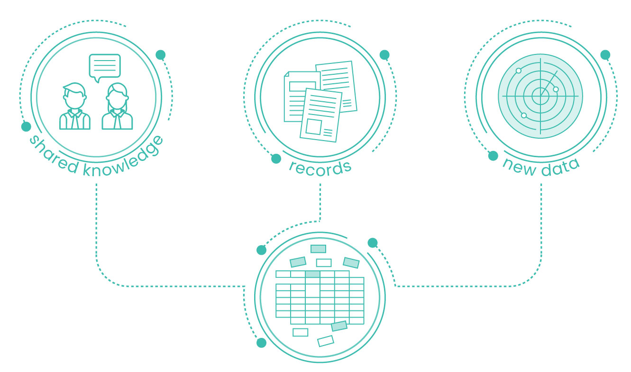
As a Data
Contributor
Collection:
Contributions to your national OBIS node both ongoing and historical
Notes:
So most of our focus this week is to increase your comfort level with identifying DarwinCore terms that match your data, and to work through some of the QC that OBIS requires, to make it easier for you to be a data contributor, for the data you collect in the future and perhaps also the historic data that may not have made it into publication yet. Going back into older datasets and surfacing them and making them fit for publication can be very valuable work, and as we’ve seen with some of the use cases, that historic data can be given the context required to support analyses and meta-analyses outside its original mandate.

Slide 4
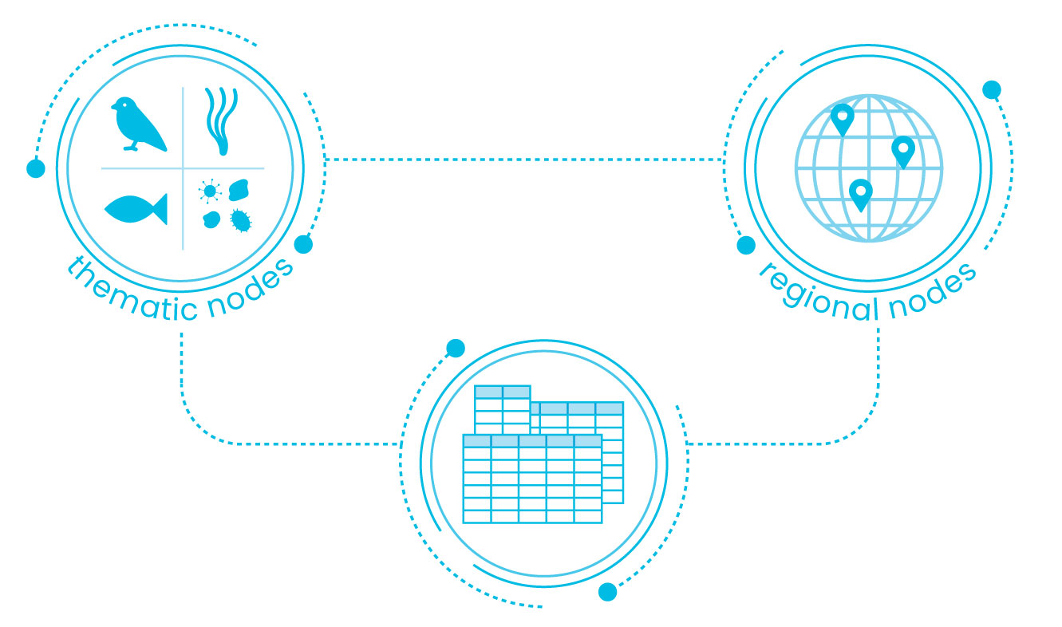
As a Data Curator
Curation:
Records currently in OBIS and OBIS Canada can be reviewed and revised to pass more of the QC checks OBIS conducts.
Subject matter expertise is irreplaceable for performing this work
Notes:
There will always be more work to do in tidying up the data that’s already in OBIS, and while I believe OBIS Canada’s in fairly good shape, reviewing the data we find there and ensuring it is in good shape smooths the pathway for that data to be considered by analysts using OBIS data. Your expertise may make you unique in spotting some of the finer points, so I would recommend browsing around datasets and trying to use them if that’s something that you might enjoy doing. You’d be doing a service to all who come after you.

Slide 5
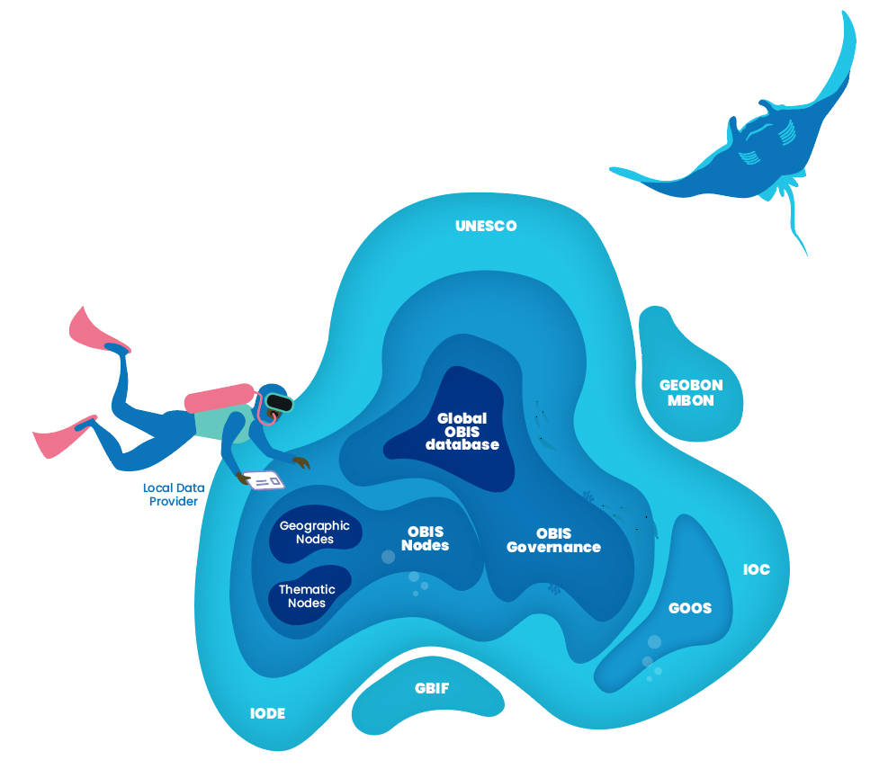
As a Software Developer
GBIF maintains the IPT @ github.com/gbif/ipt/
The robis and obistools packages : github.com/iobis
Implementations of OBIS/WoRMS API in other languages
Notes:
The IPT software is built as a Java Tomcat application, and has a small but dedicated developer base working on GitHub under the banner of the Global Biodiversity Information Facility. When we find problems and issues we can report them there, but if we’re experienced in building Tomcat apps, there is an opportunity there to pitch in and help develop the IPT to serve our purposes better.
The robis and obistools packages are developed by the OBIS project office, and are maintained on GitHub as well, and here I can tell you that you and a friend could double the number of developers working on these tools in R.
And if you’re not an R developer, say you are like me and prefer to work in Python, there are opportunities to implement things like robis or obistools in the language of your choice and bring another language the ability to check data and metadata and retrieve data records from OBIS quickly and easily.

Slide 6
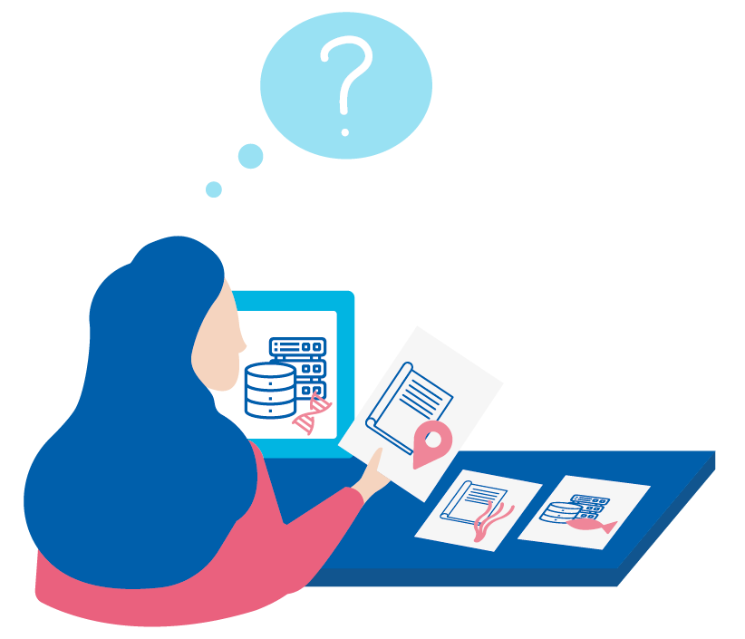
As a WoRMS Taxonomic Expert
Experts in taxonomy make WoRMS what it is.
An updated taxonomic reference with historic accepted names allows us to reference new and old taxonomic classifications at once
As with so many open data efforts, reliant on the volunteer work of experts like you
We can’t do what we do without…
Notes:
And we saw on the first day that our world registry of marine species relies on taxonomic experts around the globe to ensure the accuracy and currency of the taxonomic definitions their API returns. There aren’t that many folks in the world capable of performing this work, and if you’re one of those people, this is a pretty critical part of our biodiversity data management ecosystem, and there are some interesting questions that are going to be grappled with over the next few years at the intersection of taxonomy and biodiversity.

Slide 7
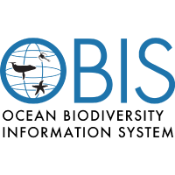


Collaborative Development
https://github.com/iobis/
https://github.com/tdwg/
Contributing to Standards and Use Cases
Determine how to map new methods to DwC and OBIS standards, working with peers in open forums
Create use-cases that guide new users on current best practices

Slide 8
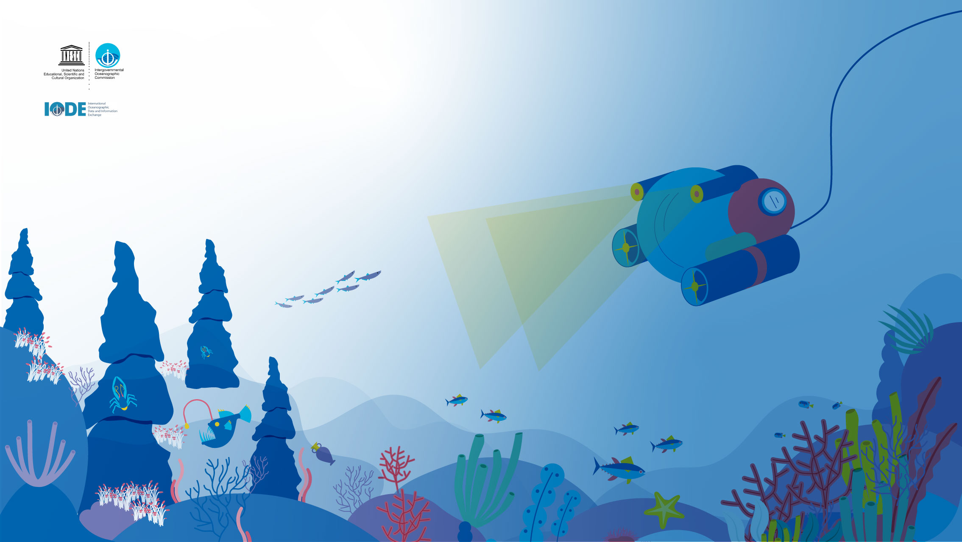
Thanks
Notes:
OBIS never misses an opportunity to thank to all the supporters, donors and the thousands of scientists and the hundreds of data managers who have been involved and contributed to OBIS. Without their efforts we would not have this fantastic resource to use today and in the future by our children.

Slide 9





@oceantrackingnetwork
@oceantracking
oceantrackingnetwork.org

